Slide 1
Coronavirus Analysis
Presented by: Nelson Arockia Raj
Last updated: May 4th, 2024

Slide 2
Table Of Contents
Coronavirus Analysis
Purpose Statement (What are we talking about?)
Key findings
Conclusion

Slide 3
What are we talking
about?

Slide 4
Conduct descriptive analytics on the COVID-19 dataset, analyzing various factors including Province, Country, Latitude, Longitude, Date, Confirmed cases, Deaths, and Recoveries.
Objective

Slide 5
Key Findings

Slide 6
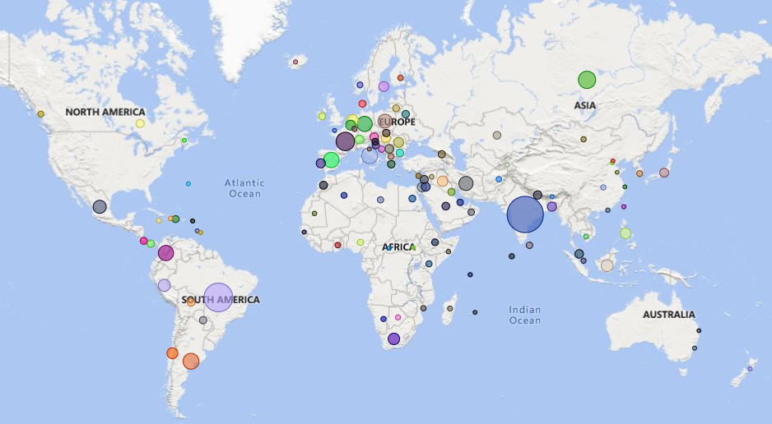
Global Confirmed Case Analysis
Confirmed cases exhibit significant variation among different provinces.
Across Europe, most provinces have higher infection rates than those in other continents.
India has the highest number of confirmed cases among all countries.

Slide 7
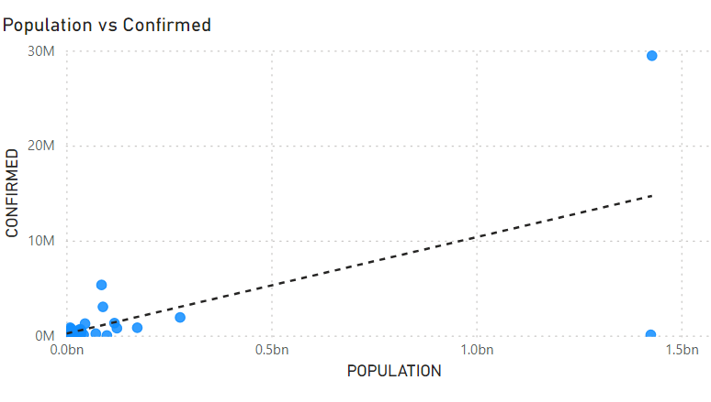
Population
Positive correlation
Positive correlation between province's population and confirmed cases
Despite China's population being similar to India's, its number of confirmed cases is significantly lower.
India, with its high population and confirmed case count, is considered an outlier among other countries.

Slide 8
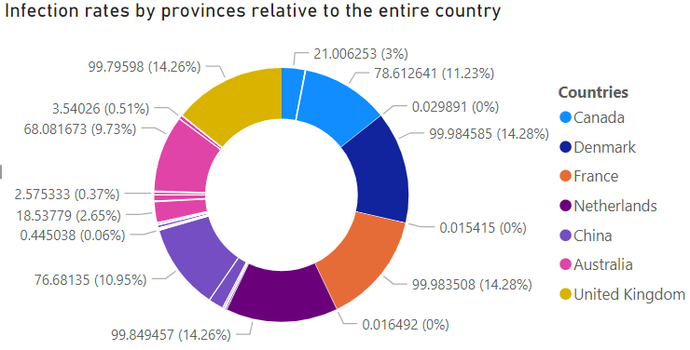
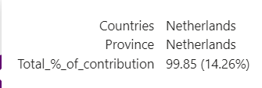
Province/Region
Except in Australia, one province in other countries significantly drives the confirmed cases count.
Provinces with higher infection rates typically experience longer recovery times from COVID-19.
Out of the 121 countries in the dataset, only 7 countries have multiple provinces represented.

Slide 9
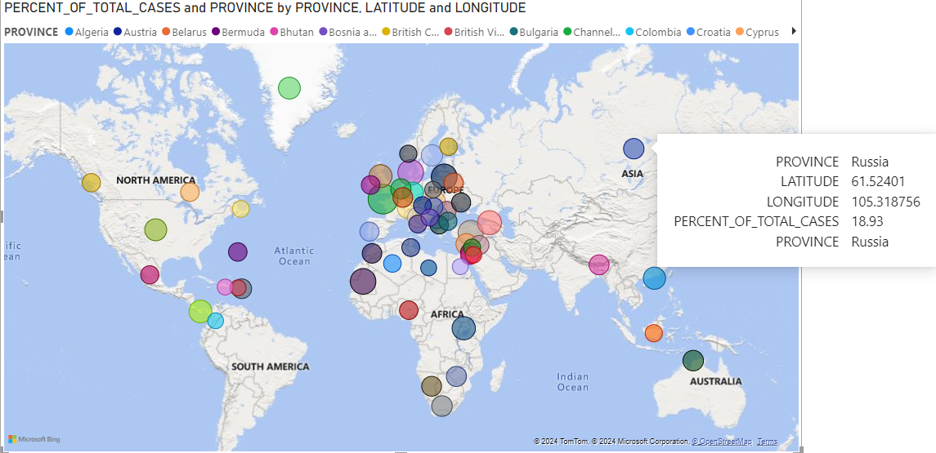
Christmas Season Impact
Christmas-celebrating regions — Europe, North America, and select African areas — saw increased infection rates
Despite participation in the outbreak, Asian nations maintained infection rates below 20% during this period.
Crowded holiday gatherings likely fueled infection rate spikes in subsequent months.

Slide 10
Conclusion

Slide 11
Conclusions
1
2
3
Europe leads in total confirmed cases among continents.
High-population countries, excluding China, show elevated confirmed case counts.
Crowded gatherings fuel outbreak spread.
* Distance from initial outbreak may influence global spread.
*Further analysis needed

Slide 12
Thank you

